Slide 1
Final Team Project Milestone 2 Selected Machine Learning Algorithm Residual Networks Super Classes: Vehicle 1 and Vehicle 2
Group 8: Aarathi Nadathur, Amar Ippili, Divya Puraswani, Sai Chaitanya Tolem, Sameer Rajput, Shubh Johri
CMPE257-Spring 2019

Slide 2
Selection Of Two Selected Sub- Classes As Testing Data.
Vehicle 1
bus
bicycle
motorcycle
pickup_truck
train
Vehicle 2
rocket
tank
streetcar
tractor
lawn_mower
Train
Data
(4800 images)
Test Data
(1200 images)
-
=
1 subclass
1 subclass
+
Test Data

Slide 3
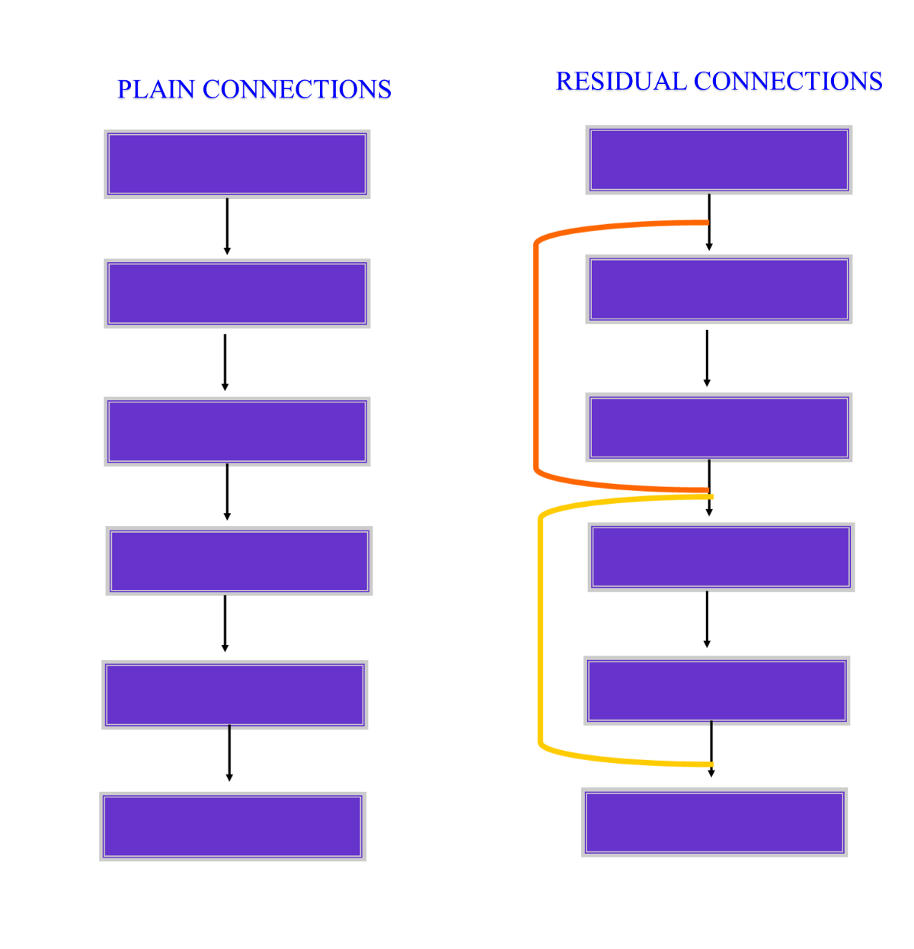



Selected Algorithm-Residual Network
A specialized network introduced by Microsoft.
Connects inputs of layers into farther part of that network to allow “shortcuts”.
$$a^{[l+1]}$$
$$a^{[l]}$$
$$a^{[l+2]}$$

Slide 4
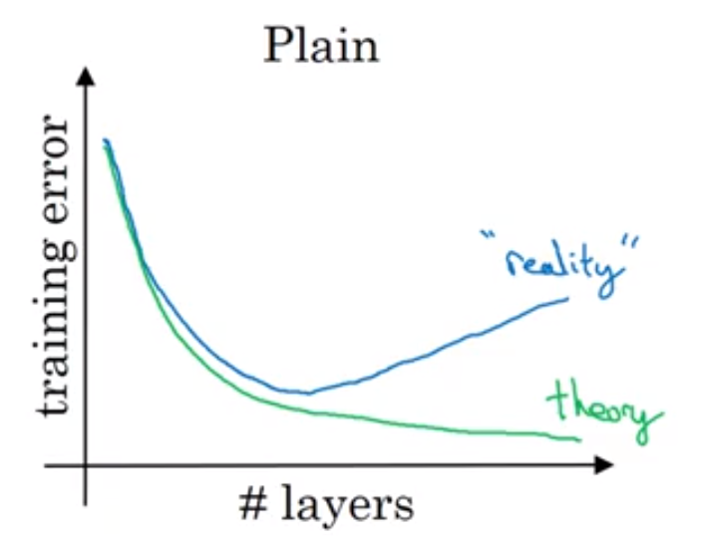
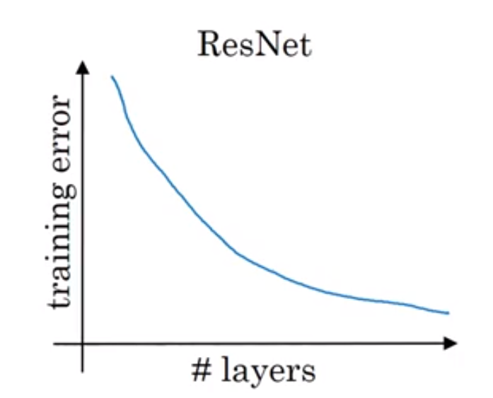
Simple idea – great improvements with both performance and train time.

Slide 5

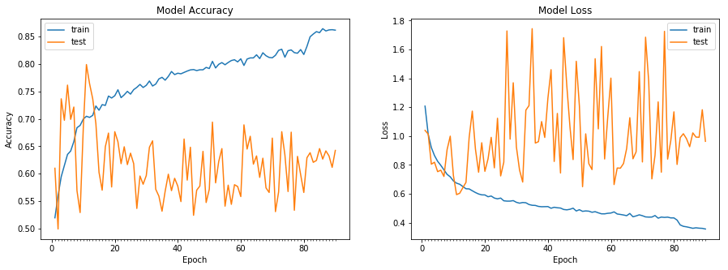
Selected Pair- motorcycle, lawn_mower
Accuracy – 79.92%

Slide 6
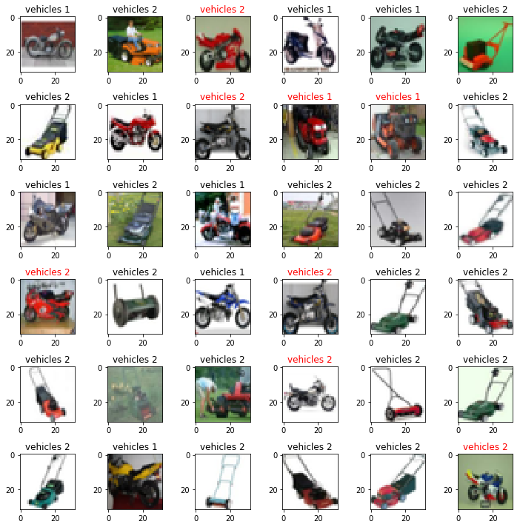
Output

Slide 7
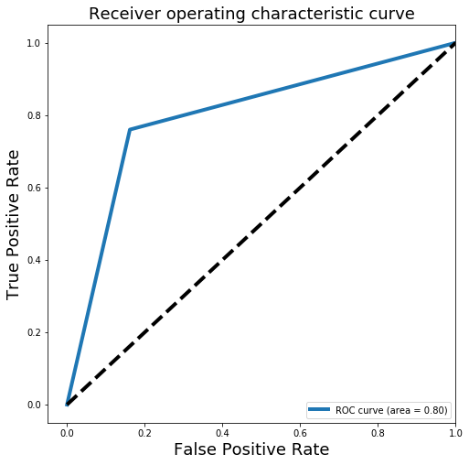
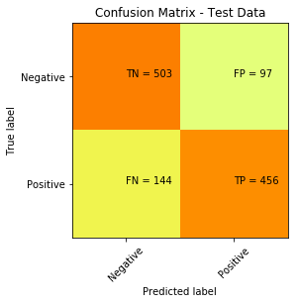
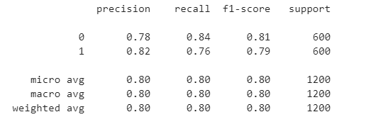
Confusion Matrix, Classification Report and ROC Curve

Slide 8
Summarized Chart
TESTING DATA – Vehicle 1 | TESTING DATA-Vehicle 2 | ACCURACY (%)
bicycle (V1). | rocket (V2) | 74.66
bicycle (V1) | tank (V2) | 61.25
bicycle (V1) | tractor (V2) | 65.08
bicycle (V1) | streetcar (V2) | 48.08
bicycle (V1) | lawn_mower(V2) | 56.41
bus (V1) | rocket (V2) | 66.25
bus (V1) | tank (V2) | 56.16
bus (V1) | tractor (V2) | 57.33
bus (V1) | streetcar (V2) | 61.58
bus (V1) | lawn_mower(V2) | 72.15
motorcycle (V1) | rocket (V2) | 63.00
motorcycle (V1) | tank (V2) | 66.91
motorcycle (V1) | tractor (V2) | 69.41
motorcycle (V1) | streetcar (V2) | 52.75
motorcycle (V1) | lawn_mower(V2) | 79.92
Pickup_truck(V1) | rocket (V2) | 63.41
Pickup_truck(V1) | tank (V2) | 58.83
Pickup_truck(V1) | tractor (V2) | 58.50
Pickup_truck(V1) | streetcar (V2) | 52.91
Pickup_truck (V1) | lawn_mower(V2) | 74.60
train (V1) | rocket (V2) | 72.50
train (V1) | tank (V2) | 52.16
train (V1) | tractor (V2) | 48.58
train (V1) | streetcar (V2) | 48.50
train (V1) | lawn_mower(V2) | 50.17

Slide 9
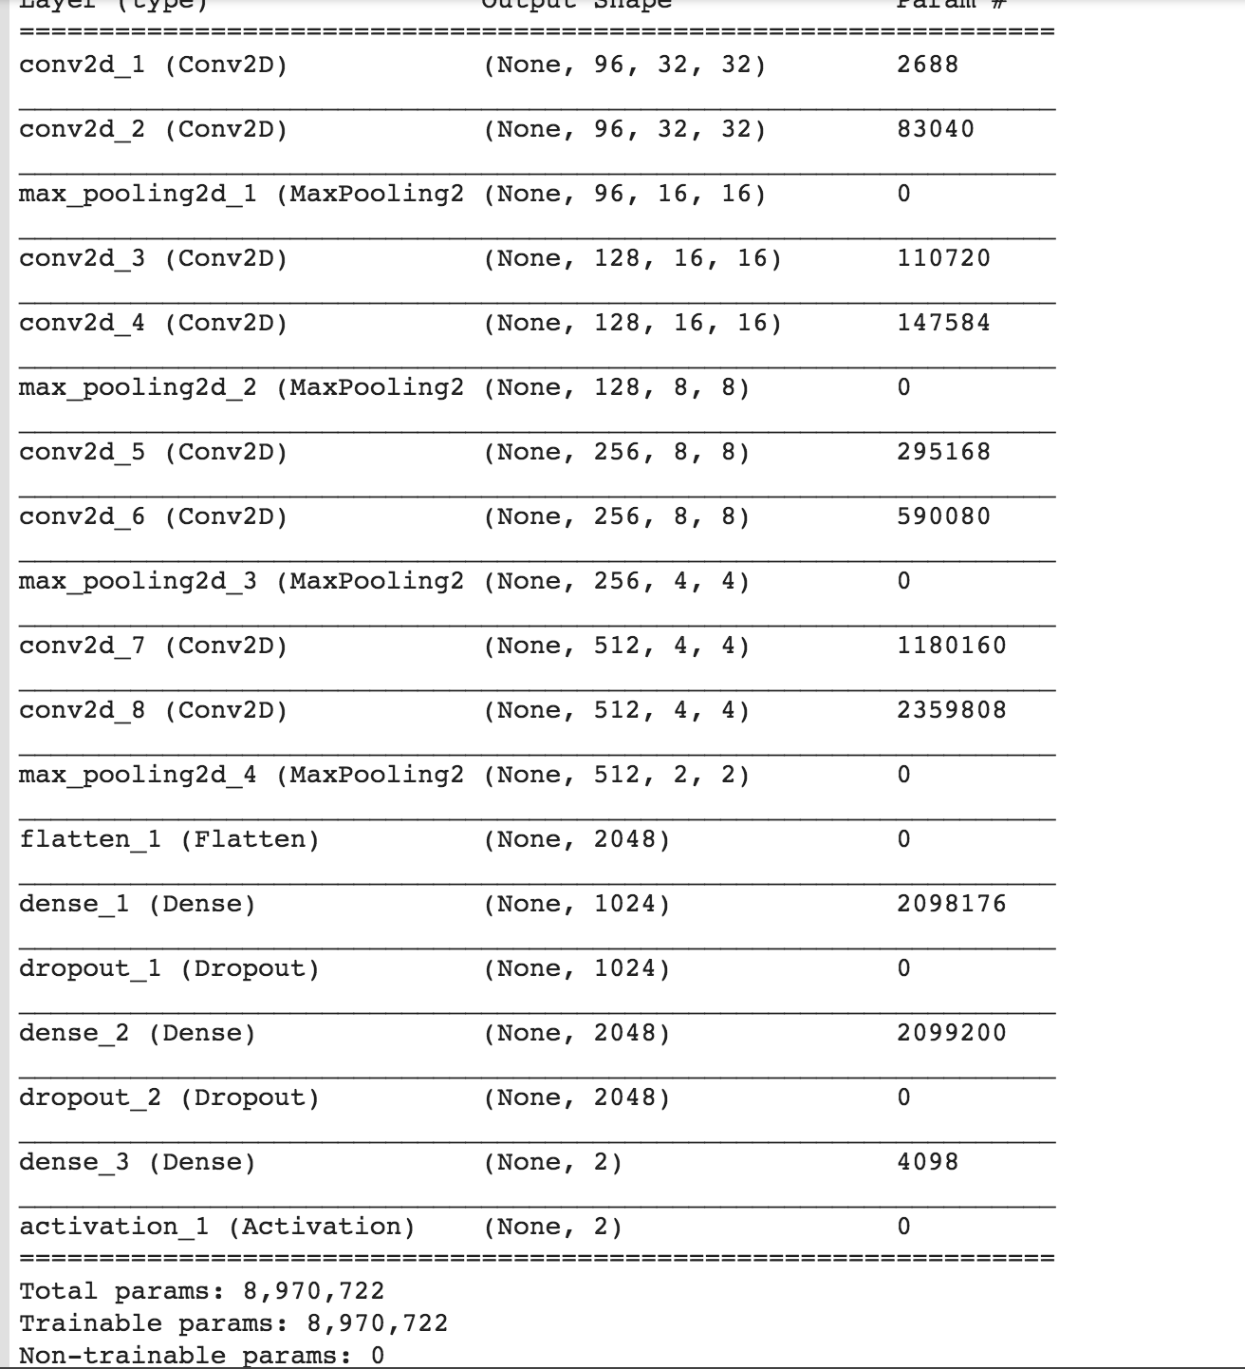
Improvements
Did tuning of parameters(steps per epoch, learning rate etc. )
ResNet

Slide 10
Lessons Learned
1. Vanishing Gradient
2. Regularizations – (kernel_regularizer)
3. Dynamic learning rates – ReduceLROnPlateau
4. ResNet – “higher number of hidden layers, better network”
5. Batch Normalization

